Slide 1
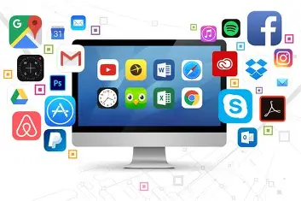
Computer

Slide 2
content
Introduction
Hardware
Software
Input devices
Output devices
Classification of computer
Uses of computer

Slide 3
Introduction
The word is derived from ‘compute’ Which means to calculate.
A Computer is an electronic device that can perform a variety of tasks by executing a given set of instructions.
Computer stand for:
Common
Operating
Machine
Particularly
Used for
Technology
Education and
Research

Slide 4
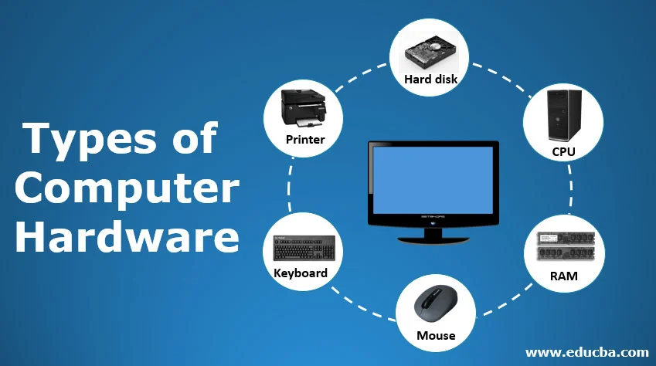
Hardware
Hardware is a electronic device .
You can feel the parts of computer.
Internal hardware devices include motherboards, hard drives and RAM.
External hardware device include monitor ,mice, printers, scanner etc

Slide 5
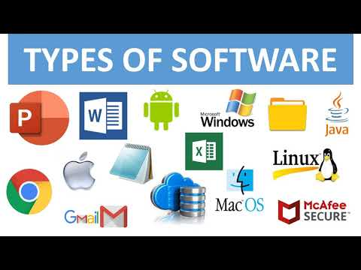
Software
Software is a collection of computer programs and related data that provide the instruction for telling a computer what to do and how to do it.
It's the intangible part of a computer system, distinct from hardware (the physical components).

Slide 6
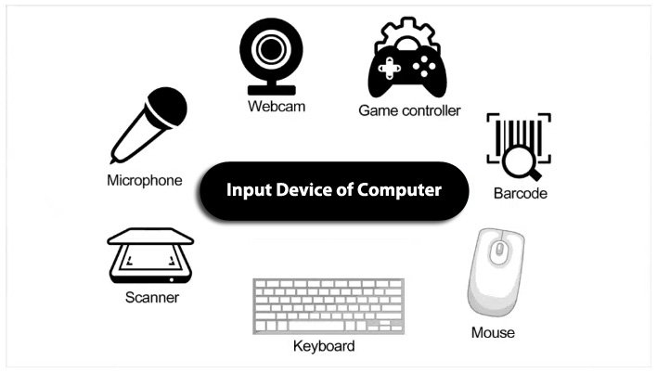
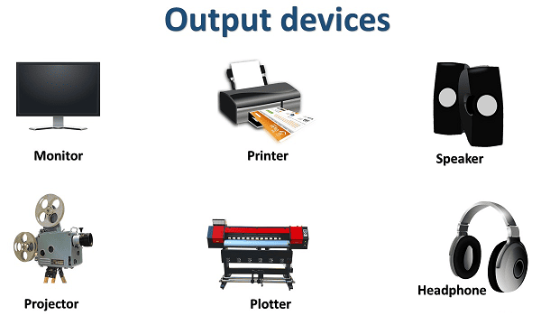
Input device
Output device
Input device are those devices which help to enter data into computer system.
Ex- keyboard, mouse, scanner ,microphone.
Output devices are those devices which help to display the processed information.
E.g. Monitor, Printer, Plotter, Projector etc.

Slide 7
Classification of computer
Based on size
1. micro computer- smallest in size, designed for individual use. Ex tablets Laptops .
2.mini computer-used in small organization for tasks like database management.
3.mainframe computer - large, powerful systems used by large organization .
4.super computer – most powerful and fastest computer. Used for complex scientific calculations, weather forecasting& research.
Based on purpose
Special purpose computer- designed to perform specific task.
Ex- embedded system in measure temperature, calculators.
General purpose computer-
Designed to perform a variety of task.
Ex- desktop computers, laptop

Slide 8
Based on work
Analog computer
processes data in continuous form.
Used for scientific and engineering applications where data is measured in physical quantity .ex- temperature ,pressure.
Digital computer
processes data in binary form(0&1).
Most common type used in business ,education and personal application .
Hybrid computer
- combines features of both analog and digital computer .
Ex- measuring heartbeat , ecg system in hospital.

Slide 9
Uses of computer
Communication
Education
Entertainment
Scientific research
Automation (AI) &(ML)
Manufacturing
Business

Slide 10
Thank you
Batch id – 241004514302

